Slide 1

CST 316
TEAM GO

Slide 2
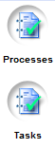
Added Panel
}
Processes and Tasks are now 2 different panel

Slide 3
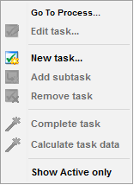
New Option in Tasks Panel
(Right click action)
Added for user convenience

Slide 4
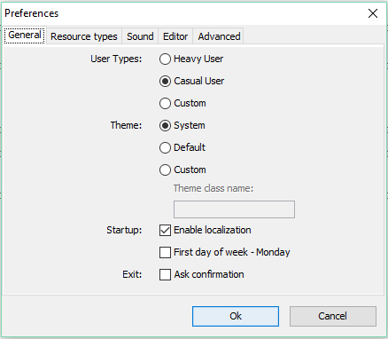
Changes in Preferences Dialog
Added for simpler selection
Renamed from
“Look and feel”

Slide 5
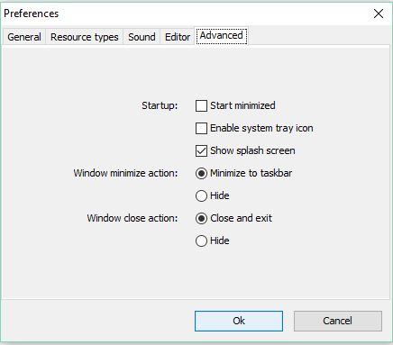
New Panel in Preferences Dialog
{
}
Entire new tab moved from “General”
Selections changed by “User types”

Slide 6
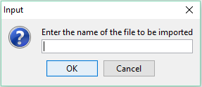
Changes in Agenda Panel Dialog Box
Updated and translated from originally Spanish

Slide 7
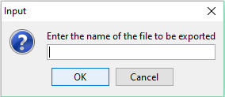
Changes in Agenda Panel Dialog Box
Updated and translated from originally Spanish

Slide 8

Changes in Agenda Panel Dialog Box
Updated and translated from originally Spanish

Slide 9
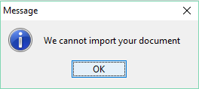
Changes in Agenda Panel Dialog Box
Updated and translated from originally Spanish

Slide 10
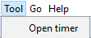
New Feature Added : Timer
Step 1
Step 2

Slide 11
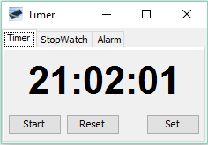
New Feature Added : Timer

Slide 12
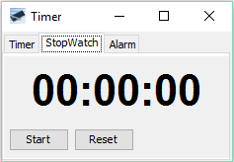
New Feature Added : Stopwatch

Slide 13
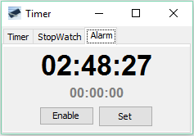
New Feature Added : Alarm

Slide 14
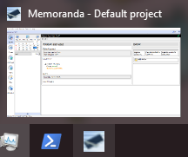
Fixes : Minimize now works properly
*Start minimized is also working as intended

Slide 15
Other Non-UI Related Changes
“Window minimize action” saved
“Item” and “Item List”
ButtonGroup “lfGroup” implementation
Default settings is “Casual” User Type
Documentations updated
Executable jar file
README.md
Webpage - http://www.public.asu.edu/~aacalde1/memoranda.html

Slide 16
#spring16TeamGO

